Slide 1


About us
Manicure
Haircuts
The best Beauty Parlor
Are you ready to come here?

Slide 2
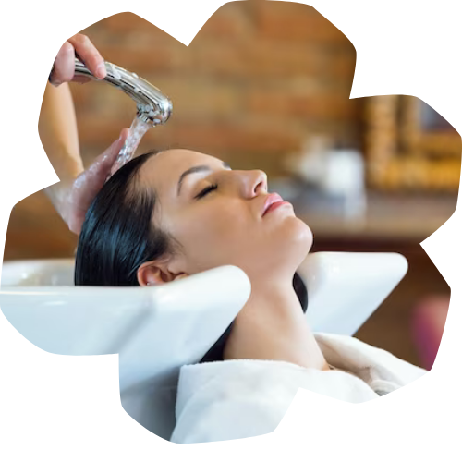
Who are we?
Welcome to Blossom Beauty Studio a place where beauty
meets relaxation! At our beauty parlor, we specialize in enhancing your
natural beauty with expert hair styling, luxurious facials,
flawless manicures, and rejuvenating skincare treatments.
Our professional team is dedicated to providing a personalized
experience in a warm and elegant atmosphere.
Whether you’re looking for a fresh new look
or a moment of self-care, we’re here to make you feel confident
and radiant. Indulge in beauty, relax in luxury visit us today!

Slide 3
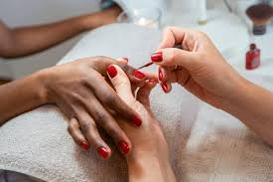
Manicure – Beauty at Your Fingertips! 💅
At Blossom Beauty Studio, we believe that well-groomed hands
make a lasting impression.
Our expert manicurists provide precise nail shaping, cuticle care,
and stunning polish finishes to match your style.
Whether you prefer a classic, gel, or intricate nail art design,
we ensure a flawless and long-lasting result.
✨ Because beautiful nails are always in style! Book
your manicure today!

Slide 4
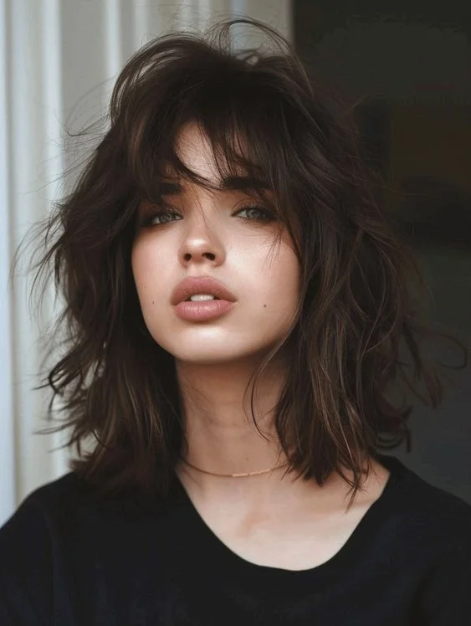
Haircuts That Define Your Style! ✂️✨
At Blossom Beauty Studio, we believe a great haircut is
more than just a trim – it's a statement!
Whether you're looking for a fresh new look, a sleek professional
style, or a bold transformation, our expert stylists are here to bring
your vision to life.
Using the latest techniques and high-quality products, we ensure
precision, style, and confidence in every cut.
💇‍♀️ Look fresh, feel confident – book your haircut today!

